Slide 1


Profile Solar

Slide 2
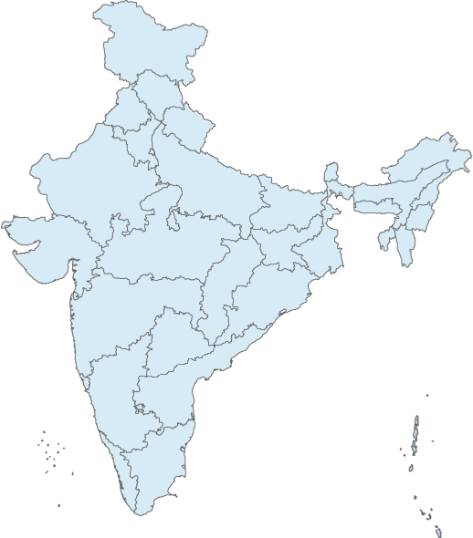

A C H I E V E M E N T
E X P E R I E N C E
PRESENCE
29 States
664 Districts
5564 Tehsils
638000Villages
150 service centre
355 service points
“India’s largest power product manufacturer”
“We have more than 12 Crore happy users”
“ Annual Turnover more than ₹ 900Cr”
All India service network[AISN]
`
EPC- Solar Roof top Off-Grid & On- Grid
P
RINCIPLE
SLOGAN
“Creating a sustainable future through building preservation, green architecture, and smart design”
Hard work, Honesty, Getting the well job done, User friendly product with cutting edge technology
WHO WE ARE?
India’s most preferred brand and is also the Most Award Brand

Slide 3






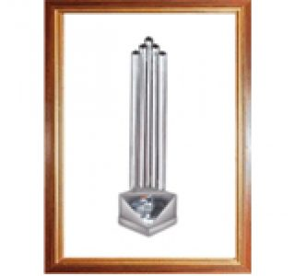





SD No. 1 Home
UPS
2013 To 2017
India’s No. 1
Brand
2016
Power Brand
2010-11
Best in after
sales service
2010
Best UPS
2015
Best in after
sales service
2009
Channels Choice
Silver Award 2008
India’s most
preferred Brand
2006
EFY Readers
Choice Award
2004-08
SD Award No. 1
Offline UPS 2001
EMPANNELLED AS CHANNEL PARTNERS
AWARDS & CERTIFICATES
Department of Renewable Energy, Govt. of Haryana.
Upto 10kWp -HAREDA
Himachal Pradesh Energy Development Agency.
1kWp to 500kWp -HIMURJA
3

Slide 4

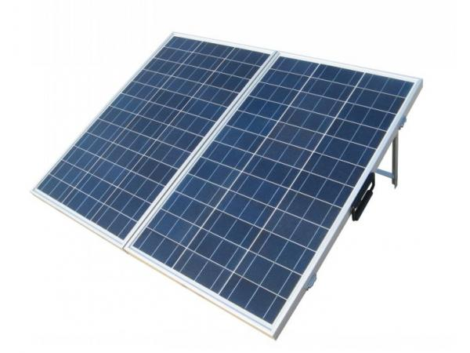


INV 01
INV n
Module Array
ACDB
On- Grid Inverter
Utility Grid
Irradiance
Ambient Temp.⁰C
Wind pressure
Real time Units generation kwh
Power DC & AC
Voltage & Current AC & DC
Remote monitoring system
Net Metering- Bidirectional
SPV POWER PLANT ARCHITECTURE
Internet
LT PANEL/ SUB - MDB

Slide 5






Drawing approval
& documentation
Civil &
structure
installation
Commissioning
& Operational
Site
survey
RFS &
Revision
Final drawing
submission
for approval
Module & Electrical
Equipment installation
PROJECTS
ROAD MAP
Preliminary
report

Slide 6
WORLD - CLASS
PRODUCTS

Slide 7
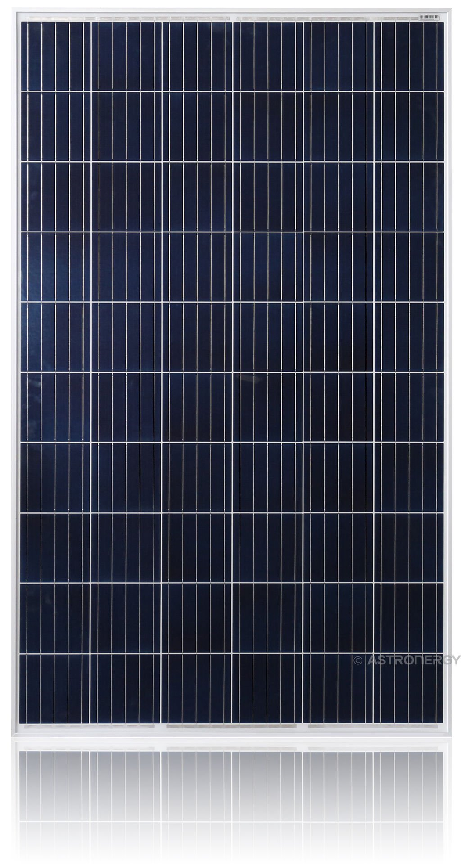

50Wp
75Wp
Voc/Vmp- 22.20/17.96V
545x665x35
Voc/Vmp- 22.20/17.96
775x665x35
2
100Wp
PV MODULE
150Wp
3
Voc/Vmp- 22.10/17.96V
1010x665x35
Voc/Vmp- 22.20/18.55
1495x665x35
4
260Wp
320Wp
5
Voc/Vmp- 37.60/31.00V
1639x991x35/40
Voc/Vmp- 45.00/36.20V
1639x991x40
6
5BB MODULE
50Wp to 320Wp
PV MODULES
3.27 Lacs PV Panel Sold out and the total capacity -87.65MWp

Slide 8
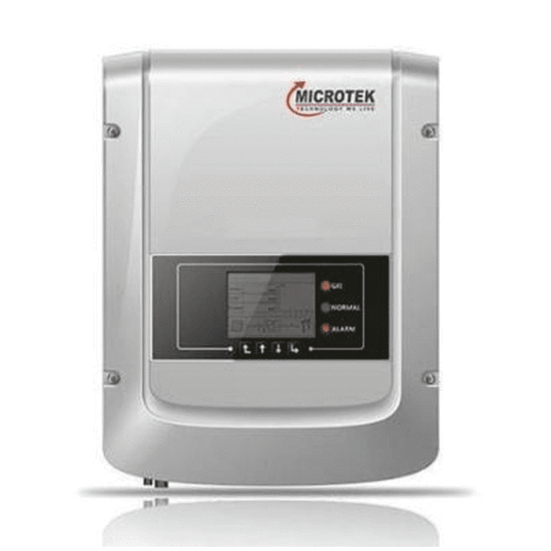
1
2
3
1000W[1kW]
2200W[2kW]
3000W[3kW]
1MPPT, Single Phase
1MPPT, Single Phase
1MPPT, Single Phase
4
5
6
5200W[5kW]
5500W[5.5kW]
2MPPT, Three Phase
12000W[11kW]
2MPPT, Single Phase
2MPPT, Three Phase
MPPT BASED
ON-GRID PCU
7
20800W[20kW]
2MPPT, Three Phase
Installed 1.03MW PAN India

Slide 9
1kW TO 20kW INSTALLATION
GRID TIED PCU

Slide 10
SOLAR PROJECTS

Slide 11
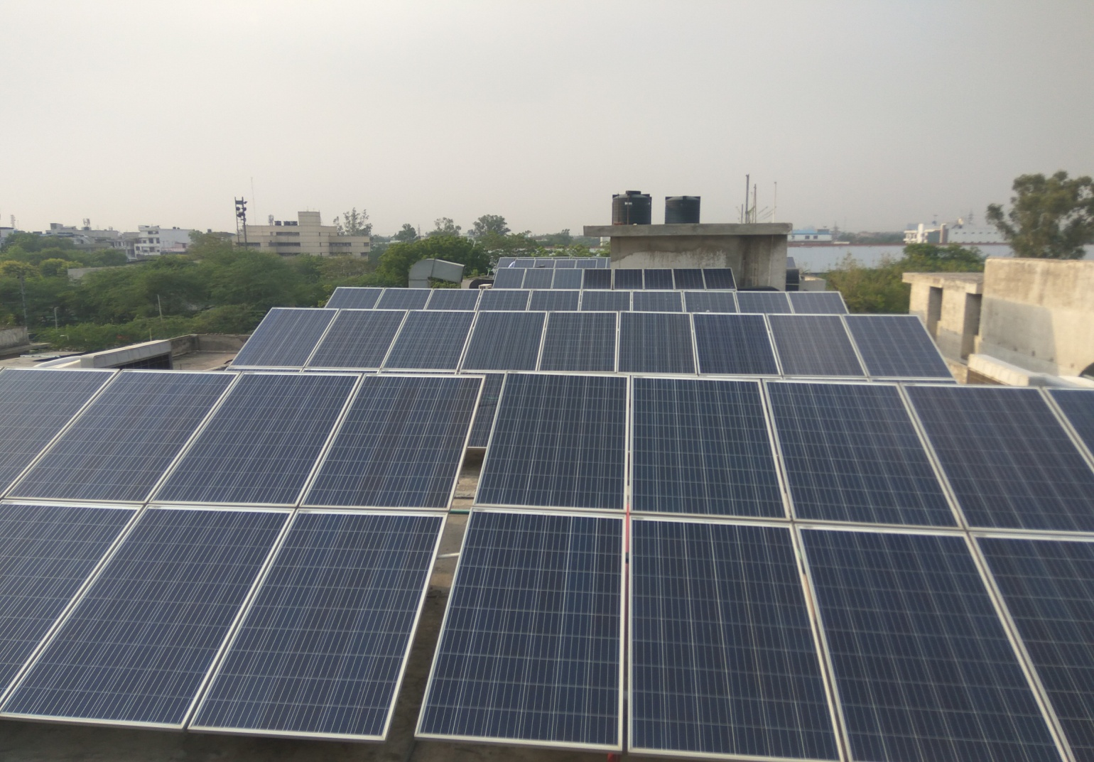
36kWp ROOF TOP POWER PLANT, H-56,NEW DELHI.
Module: Polycrystalline
Scope of work: Turnkey EPC
Off Taker: Microtek
Commissioned on: 08 June 17
Daily Energy Generation: 4kWh/kWp
New Delhi
CONCRETE ROOF TOP
36kWp

Slide 12
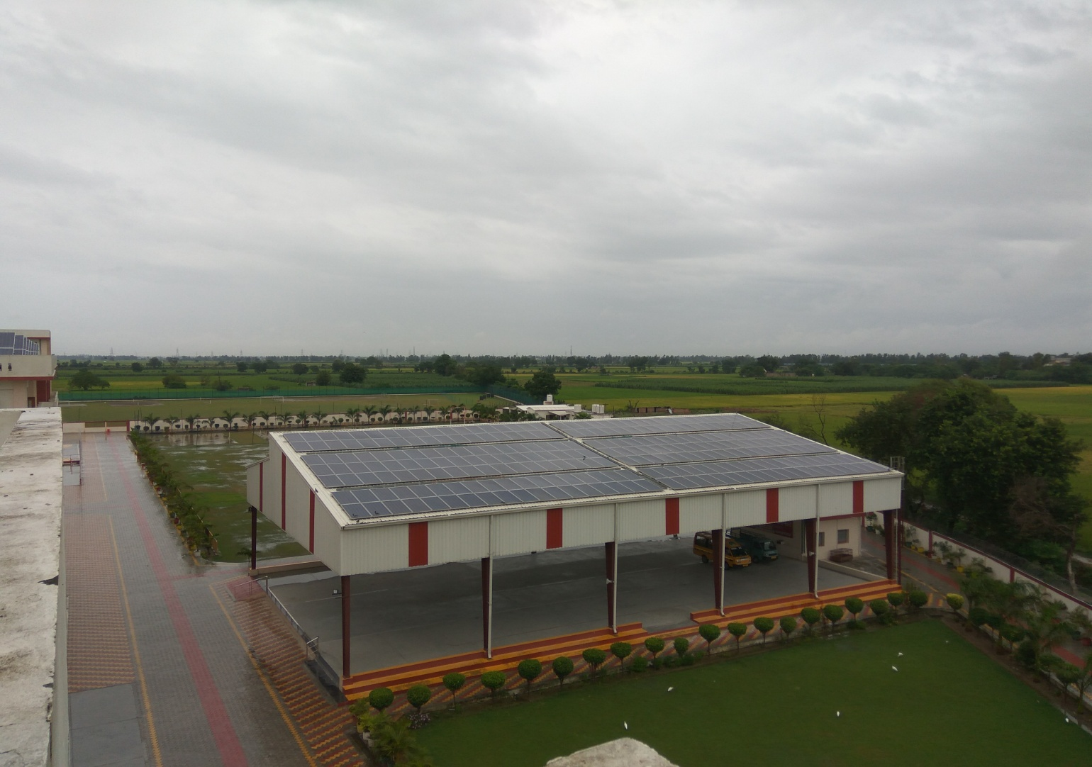

80kWp ROOF TOP POWER PLANT,HARYANA.
Module: Polycrystalline
Scope of work: Turnkey EPC
Off Taker: The Gurukul
Commissioned on: 24 May 18
Daily Energy Generation: 4kWh/kWp
Nilokheri
METAL SHED ROOF TOP
80kWp

Slide 13
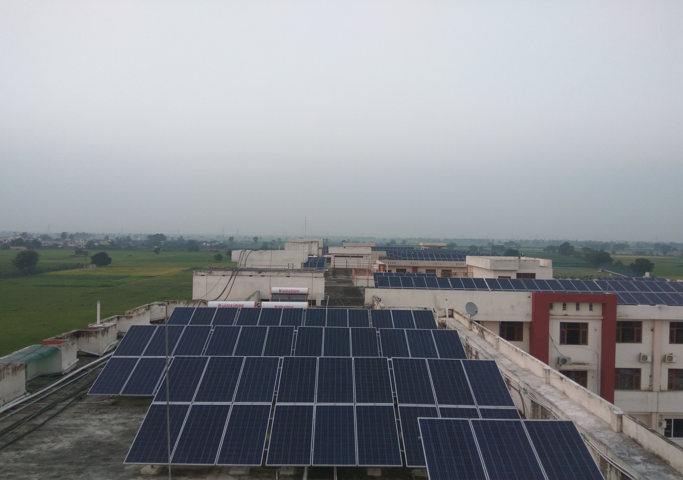
200kWp ROOF TOP POWER PLANT,HARYANA.
Module: Polycrystalline
Scope of work: Turnkey EPC
Off Taker: The Gurukul
Commissioned on: 24 May 18
Daily Energy Generation: 4kWh/kWp
Nilokheri
CONCRETE ROOF TOP
200kWp

Slide 14
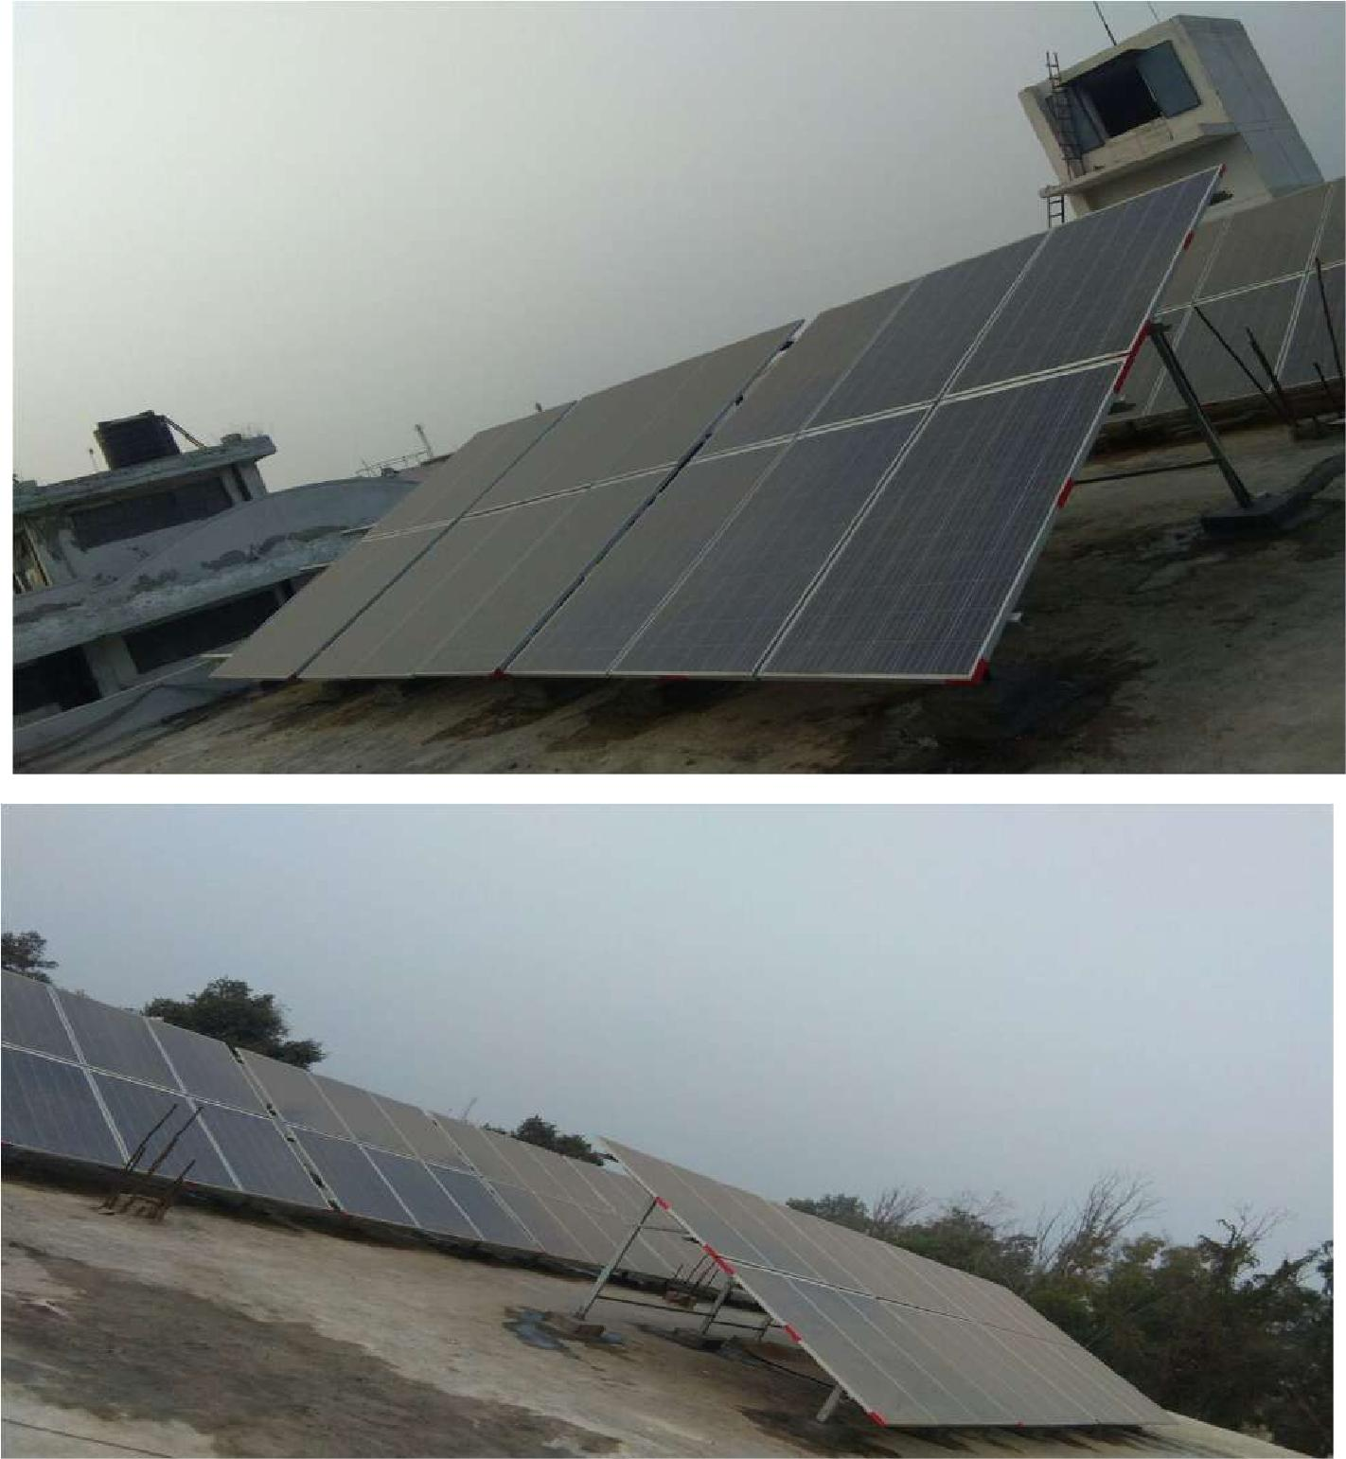
60kWp ROOF TOP POWER PLANT,HARYANA.
Module: Polycrystalline
Scope of work: Turnkey EPC
Off Taker: Microtek
Commissioned on:
Daily Energy Generation: 4kWh/kWp
Kundli
CONCRETE ROOF TOP
60kWp

Slide 15
CONTACT US
H.O:- H-57 Udyog Nagar, Rohtak Road, New Delhi-110041
Ph.:-011- 71255500 , Mob: +919871288907,+918448296704
E-mail : solarprojects@microtekdirect.com,
www.microtekdirect.com

